Slide 1


Food and nutrition labelling
Prof.ssa Paola Pittia
Facoltà di Bioscienze e Tecnologie Agro-alimentari ed ambientali
Università di Teramo
ppittia@unite.it
Amman (Jordan)
28° April 2018
Amman (Jordan)
28° April 2018

Slide 2
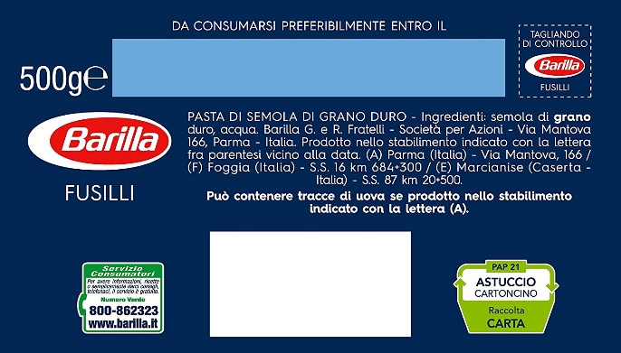
Food labelling: definitions
World Health Organization (WHO)
“any written, printed or graphic matter that is present on the label, accompanies the food, or is displayed near the food, including that for the purpose of promoting its sale or disposal”.
EC (Regulation EC n. 1169/2011)
…. (i) ‘label’ : means any tag, brand, mark, pictorial or other descriptive matter, written, printed, stencilled, marked, embossed or impressed on, or attached to the packaging or container of food;
(j) ‘labelling’ means any words, particulars, trade marks, brand name, pictorial matter or symbol relating to a food and placed on any packaging, document, notice, label, ring or collar accompanying or referring to such food; ….

Slide 3
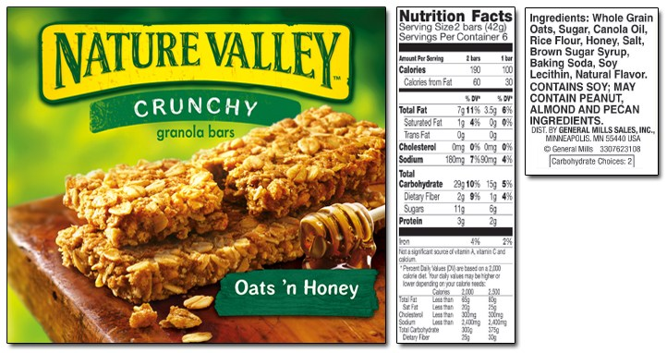
Food labelling: definitions
US (FDA)
https://www.fda.gov/Food/LabelingNutrition/default.htm
- No main definitions
- Guide for food labelling (2013)
Codex - General Standard for labelling of pre-packed foods (1985)
‘Labelling’ includes any written,
printed or graphic matter that is
present on the label,
accompanies the food, or is
displayed near the food,
including that for the purpose of
promoting its sale or disposal

Slide 4
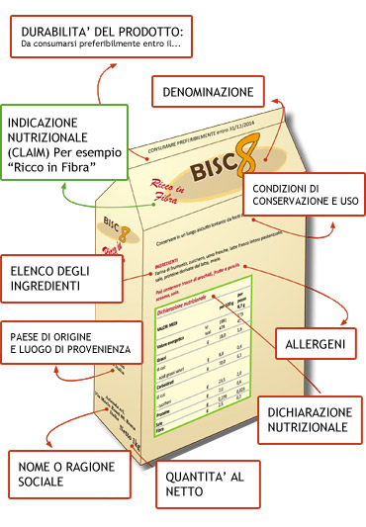
Food label
What is and what contains a label
It is the identity card of the food.
Offers complete information on characteristics, ingredients, quality ingredients and quality of food products useful purchase choices
ROLE:
- Food producers: aid in selling the product and to inform consumers
- Consumers: informed choice at purchase
SILENT SELLER…
TRUE
CLEAR
EXAUSTIVE
IDENTITY CARD
MARKETING TOOL

Slide 5

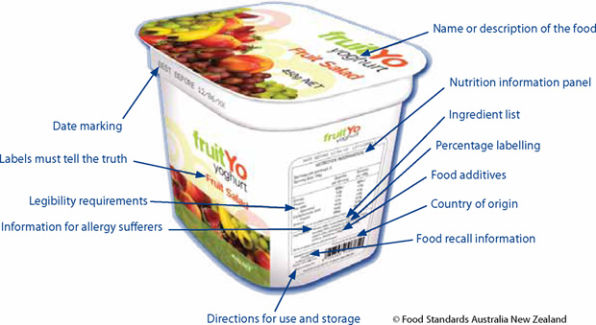
Food labelling
…SOME HISTORY
the information conveyed by food labels has evolved over time.
In the past few years, the objectives of food labelling have become numerous and complex under the influence of food legislation, food companies, retailers, public authorities and the consumers.
PAST…
NOW…
Name, ingredients, producer, best consume before…

Slide 6
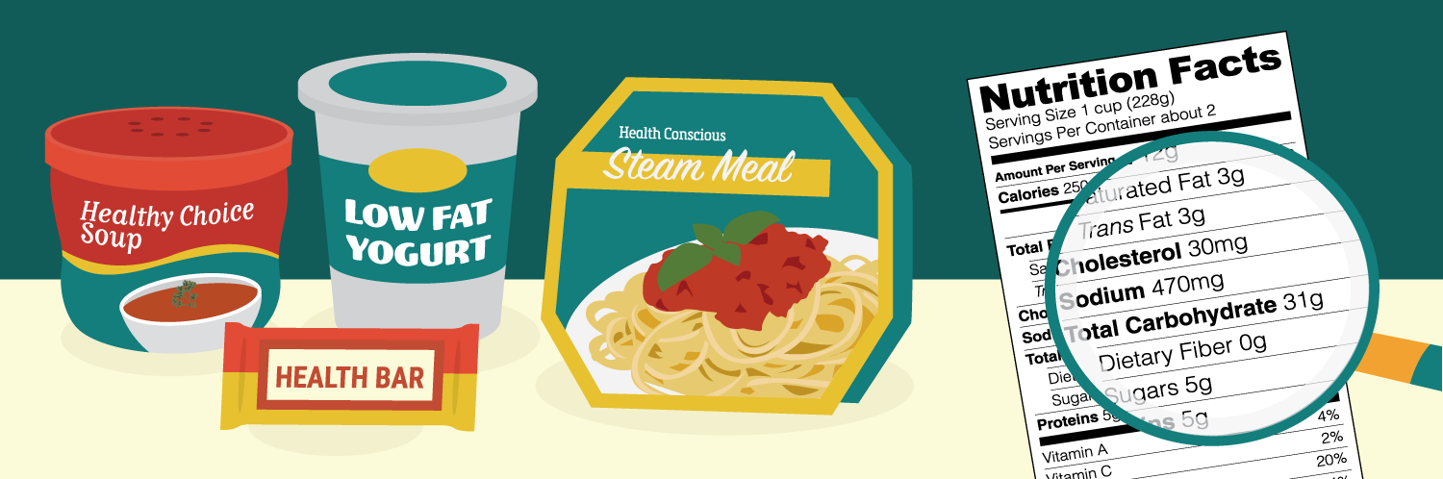
Food labelling
Some information on food labels is:
Mandatory - the manufacturer/packer has to include it by law.
Voluntary – the manufacturer/packer may or may not include it.

Slide 7
Labelling: history
Comunication and information
….
First formulated products
Name
WHAT IS ?
Composition of a food
RECIPY AND FORMULATION
Innovative tecnologies
1960
Durability
HOW LONG IT KEEPS ITS SAFETY AND QUALITY
Market globalisation
1970
Usage and storage conditions
HOW CAN I USE IT?
1990
Where it is produced/packed
Traceability
WHERE IT HAS BEEN MADE/PACKED?
2000
Health & diet
Series number
CAN I TRACE THE PRODUCT ?
2006
Food safety
Nutrizional value
MY DIET…..
2003
Allergens and other components with health/physiological effects
WE ARE WHAT WE EAT….

Slide 8
Food labelling: regulations
EUROPE
REGULATION (EU) EC N. 1169/2011
  In place from 2011 but compulsory only from 13.12.2014
- nutritional labelling: compulsory from 13/12/2016 (before, only on voluntary basis)
U.S.
Food & Drug Administration (FDA): responsible for assuring that foods (produced domestically and from foreign countries) sold in the US are safe, wholesome and properly labeled. Reference laws:
  The Federal Food, Drug, and Cosmetic Act (FD&C Act) and the Fair Packaging and Labeling Act, as amended by the Nutrition Labeling and Education Act (NLEA) https://www.fda.gov/Food/LabelingNutrition/default.htm

Slide 9
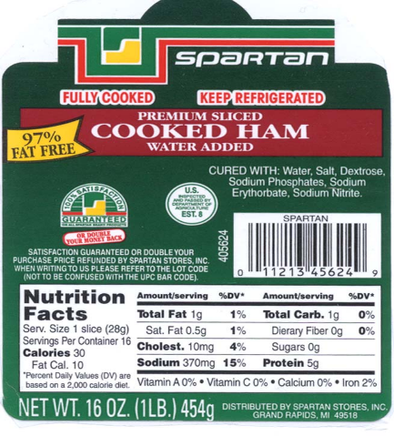
Food labelling
Food Information:
Food information is all information provided to the end consumer by
  label
  other accompanying material
  any other means including modern technology tools or verbal communication
  (e.g. advertisment, internet, catalogues)

Slide 10
Food labelling: what
The information provided by food labelling have to comply with the following:
BE TRUE and not be misleading the consumer
In particular :
a) Regarding the characteristics of the food (nature, identity, properties, composition, quantity, durability, country of origin or place of provenance, method of manufacture or production);
(b) by attributing to the food effects or properties which it does not possess;
(c) by suggesting that the food possesses special characteristics when in fact all similar foods possess such characteristics, in particular by specifically emphasising the presence or absence of certain ingredients and/or nutrients;
(d) by suggesting, by means of the appearance, the description or pictorial representations, the presence of a particular food or an ingredient, while in reality a component naturally present or an ingredient normally used in that food has been substituted with a different component or a different ingredient.

Slide 11
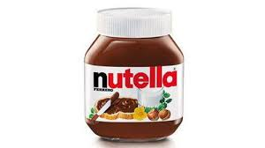
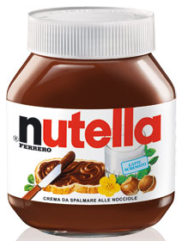
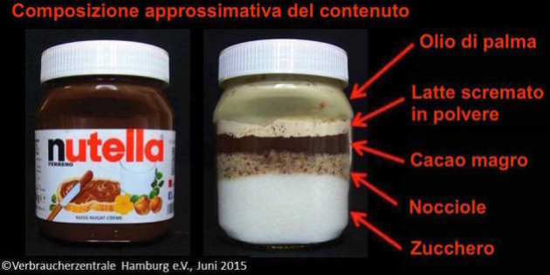
Food labelling: what
The information provided by food labelling have to comply with the following:
BE TRUE and not be misleading the consumer

Slide 12
Food labelling: what
The information provided by food labelling have to comply with the following:
CLEAR and EASY to be read and understood
  Regulations and instructions for the texts fon and size and where to be displaid
  Language translations
NO modifications are allowed during food shelf-life
These principles are applied also to the
a) advertisements;
b) Presentation of the foods (shape, package style, packaging materials, how they are displaied, etc…)

Slide 13
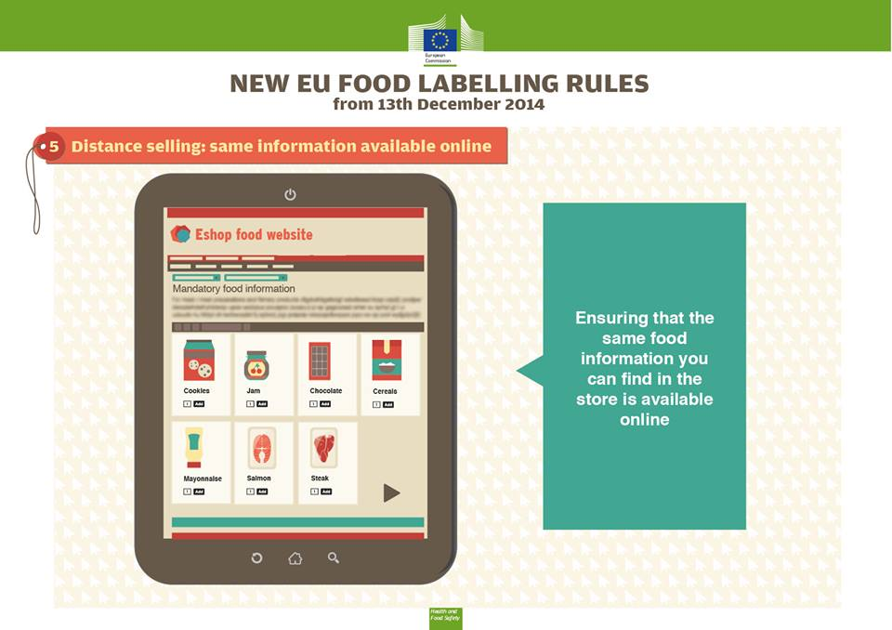
Food labelling : to what products?
Any food intended for supply to the final consumer or mass caterers has to be accompanied by food information in accordance with this regulation.
Pre-paked
Packed at the place of selling
…included products sold on-line in the web

Slide 14
Application
Food business operators at all stages of the food chain,
if their activities concern the provision of food information to consumers.
All sorts of food provided to the end consumer, including
    foods delivered by mass caterers
    foods intended to be delivered to mass caterers
Catering services which provide food transport services , if the departure takes place on the territories of the Member States to which the Treaties apply (e. g. Airline Catering, Catering on cruising ships)

Slide 15
Food label: mandatory contents
COMPULSORY (EC 1169/2011, art. 9)
Name of the food
Name or business name and the address of the food business operator being responsible for placing on the market (ref. Art. 8)
List of ingredients
Date of minimum durability (“shelf live”)or the “use by” date
The quantity of certain ingredients or categories of ingredients
Alcoholic strength for beverages with more than 1,2% by volume of alcohol
Ingredients mentioned in Appendix II causing allergies or intolerances
The net quantity of the food
Storage conditions and/or conditions of use
Country of origin or place of provenance (Art. 26)
Nutrition declaration

Slide 16
Food label: mandatory contents
COMPULSORY
Product Name
Convenience
Composition
List of Ingredients
Instructions for Use
Name and
Address of Manufacturer
Storage Instructions
traceability
Country of
Origin
Shelf Life
Quality and safety
Weight of Product

Slide 17

Food label: mandatory contents
List of the ingredients
Name of the product
Additional use condition
Any ingredient Annexe II
Any storage and use condition
Name/business name, place of packaging/processing
Nutritional info
Identity key
Size/weight

Slide 18
Food label: mandatory contents

Slide 19
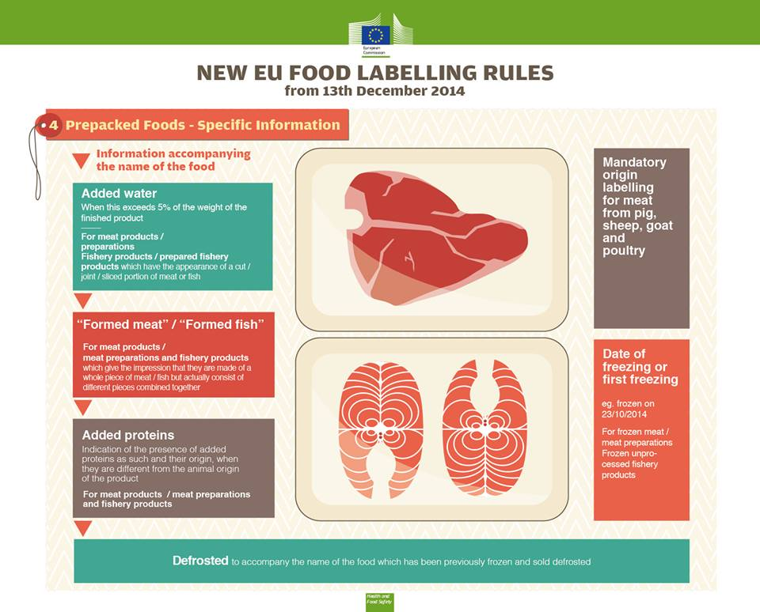
Labelling: origin and authenticity
Addition of proteins (in processed meat and fish) when different from that of the initial raw material;
Water: in processed meat products (if > 5%);
Fish/meat reconstituted (claim)
Minced meat

Slide 20
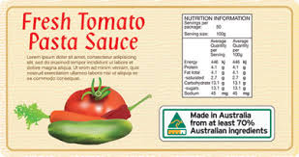
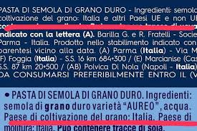
Labelling: origin and authenticity
Origin:
Compulsory when this could mislead the consumer (es. mozzarella produced in Germany)
Compulsory if connected to Protected Origin Declarations (PDO, PGI)
National regulations (Italy):
Pasta
Tomato product

Slide 21
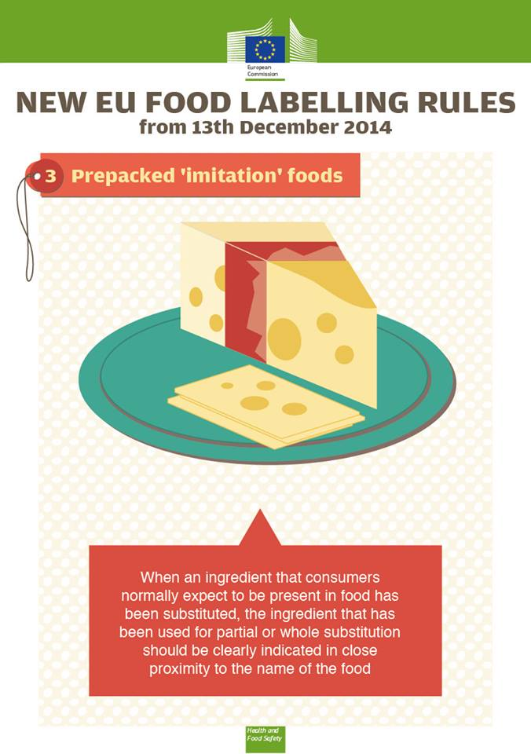
Labelling: origin and authenticity
Substitution of an ingredient that is characteristic of that product (eg. Egg in maionnaise, substituted by soia proteins
= text next to the name of the product

Slide 22
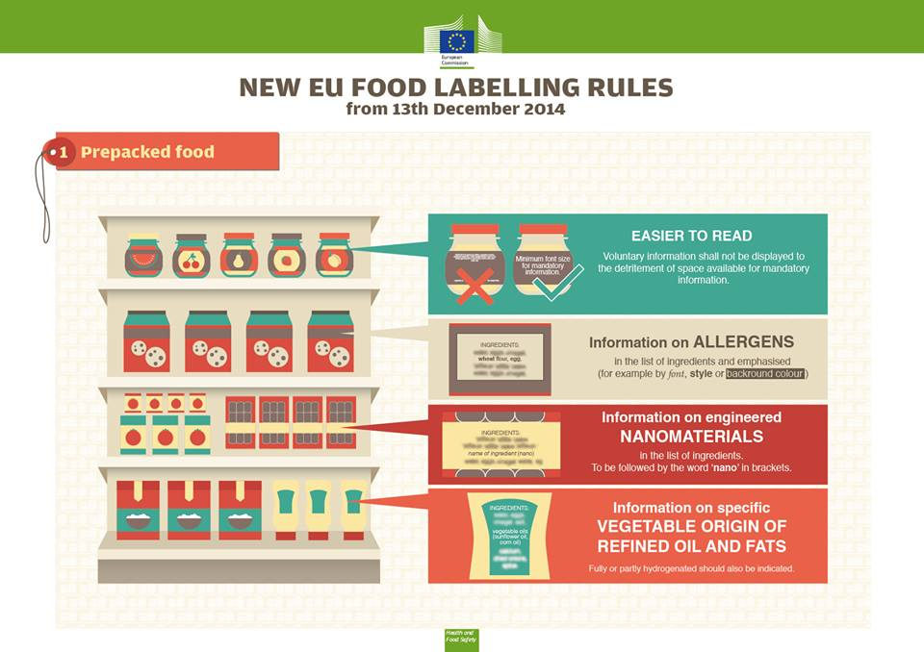
Labelling: origin and authenticity
Nanomaterials: mentioned in the list of the ingredients
= safety

Slide 23
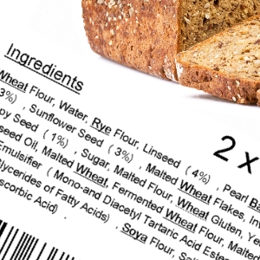
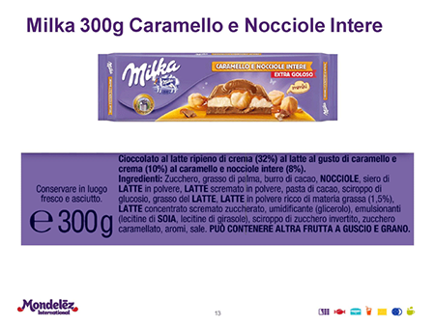
Labelling of Ingredients causing allergies or intolerances
Allergen labelling”
Indication in the list of ingredients with a clear reference to the name of the substance or product as listed in Annex II
  - the name of each allergenic substance shall be emphasized through the font, style or background colour
If a list of ingredients is not necessary: term “contains” followed by the name of the substance or product as listed in Annex II
No allergen labelling in the list of ingredients is necessary, if the name of the food clearly indicates, that a allergen is present

Slide 24
Labelling of Ingredients causing allergies or intolerances
PRESENCE/ABSENCE
Cereals containing gluten and products thereof | Nuts and almonds
Crustaceans and products thereof | Celery and products thereof
Eggs and products thereof | Mustard and products thereof
Fish and products thereof | Sesame seeds and products thereof
Peanuts and products thereof | Sulphur dioxide and sulphites at concentrations of more than 10 mg/kg
Soybeans and products thereof | Lupine and products thereof
Milk and products thereof | Molluscs and products thereof

Slide 25
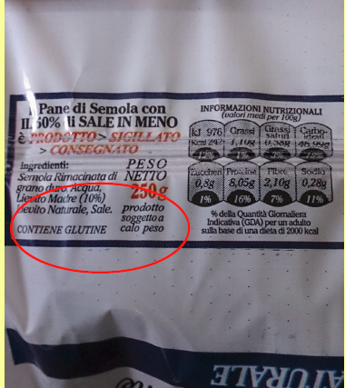
Labelling of Ingredients causing allergies or intolerances

Slide 26
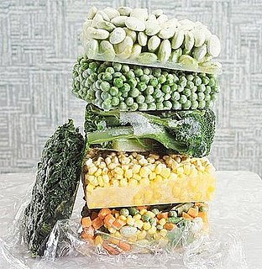
Labelling and processing
Freezing & FROZEN FOODS (except ice-cream)
«FROZEN ON….date»
«DEFROSTED ….»
..Dried products (e.g. powdered milk)

Slide 27
Food and nutrition Labelling
COMPULSORY
Product Name
Convenience
Composition
List of Ingredients
Instructions for Use
Name and
Address of Manufacturer
Storage Instructions
traceability
Country of
Origin
Shelf Life
Quality and safety
Weight of Product
Some info as food technologists are already present here…..but only for experts

Slide 28
Food and nutrition Labelling
EC 1169/2011
(Reg. EU 1169/2011, Annex I)
«Nutrition declaration’ or ‘nutrition labelling’ means information stating the:
(a) energy value; or
(b) energy value and one or more of the following nutrients only: fat (saturates, mono-unsaturated, polyunsaturated), carbohydrate (sugars, polyols, starch), salt, fibre, protein, any of the vitamins or minerals listed in point 1 of Part A of
Annex XIII (…)
Codex - General Guide on Nutrition labelling (1985)
2.1 Nutrition labelling is a description intended to inform the consumer of
nutritional properties of a food.
2.2 Nutrition labelling consists of two components: (a) nutrient declaration;
(b) supplementary nutrition information.
2.3 Nutrient declaration means a standardized statement or listing of the nutrient content of a food.

Slide 29
Food and nutrition Labelling
EC 1169/2011 – MANDATORY
1. The mandatory nutrition declaration shall include the following:
(a) energy value; and
(b) the amounts of fat, saturates, carbohydrate, sugars, protein and salt.
2. The content of the mandatory nutrition declaration referred to in paragraph 1 may be supplemented with an indication of the amounts of one or more of the following:
(a) mono-unsaturates;
(b) polyunsaturates;
(c) polyols;
(d) starch;
(e) fibre;
(f) any of the vitamins or minerals listed in point 1 of Part A of Annex XIII, and present in significant amounts as defined in point 2 of Part A of Annex XIII.
Where appropriate, a statement indicating that the salt content is exclusively due to the presence of naturally occurring sodium may appear in close proximity to the nutrition declaration.

Slide 30

Food and nutrition Labelling
Nutrients are listed as amount:
  per 100g or
  per serving or
  both.
Energy is listed in kilocalories or kilojoules
For some nutrients they are referred to GDAs = Guideline Daily Amounts
G.D.A.s: (%) of the amount of a nutrient that you are recommended to consume daily is provided by a portion of the product.
G.D.A.s found on the food label are based on the recommendations for an average adult or child of healthy weight and average activity level.

Slide 31
Food and nutrition Labelling

Slide 32
Food and nutrition Labelling

Slide 33
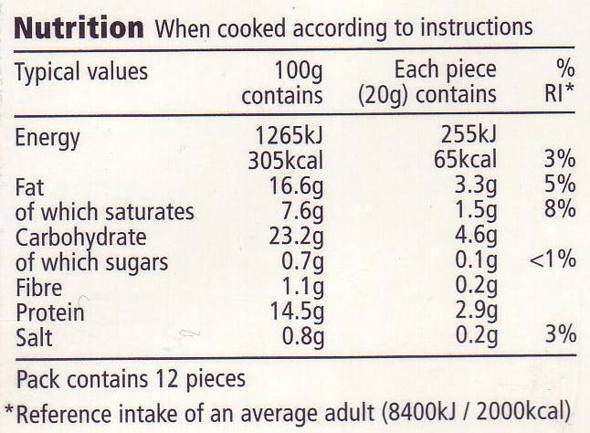
Food and nutrition Labelling

Slide 34
Food and nutrition Labelling

Slide 35
Exemption to nutrition labelling
The following products are exempted from mandatory nutrition labelling, except when a nutrition or a health claim is made:
1. Unprocessed products that comprise a single ingredient or category of ingredients;
2. Processed products which the only processing they have been subjected to is maturing and that comprise a single ingredient or category of ingredients;
3. Waters intended for human consumption, including those where the only added ingredientsare carbon dioxide and/or flavourings;
4. A herb, a spice or mixtures thereof;
5. Salt and salt substitutes;
6. Table top sweeteners;
7. Coffee extracts and chicory extracts, whole or milled coffee beans and whole or milled decaffeinated coffee beans;
8. Herbal and fruit infusions, tea, decaffeinated tea, instant or soluble tea or tea extract, decaffeinated instant or soluble tea or tea extract, which do not contain other added ingredients than flavourings which do not modify the nutritional value of the tea;
9. Fermented vinegars and substitutes for vinegar, including those where the only added ingredients are flavourings;
10. Flavourings;
11. Food additives;
12. Processing aids;
13. Food enzymes;
14. Gelatine;
15. Jam setting compounds;
16. Yeast;
17. Chewing-gums;
18. Food in packaging or containers the largest surface of which has an area of less than 25 cm2;
19. Food, including handcrafted food, directly supplied by the manufacturer of small quantities of products to the final consumer or to local retail establishments directly supplying the final consumer;
20. Alcoholic beverages (containing more than 1.2% alcohol);
21. Non-prepacked foods

Slide 36
Nutrition claims
FDA (US)

Slide 37
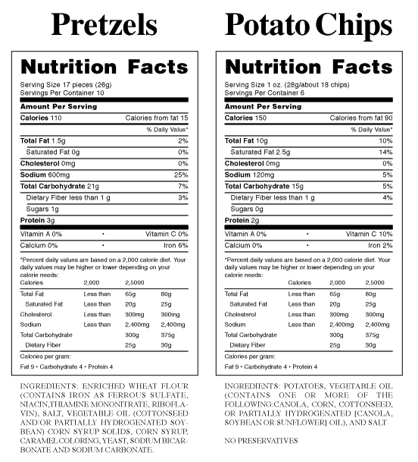
Nutrition claims
FDA (US)

Slide 38
Nutrition claims
Cavalieri et al., 2015- Food quality and Preference

Slide 39
Nutrition claims
“Any claim which states, suggests or implies that a food has particular nutritional properties due to:
(a) the energy (calorific value) it (i) provides, (ii) provides at a reduced or increased rate, or (iii) does not provide, and/or
(b) the nutrients or other substances it (i) contains, (ii) contains in reduced or increased proportions, or (iii) does not contain”

Slide 40
Nutrition and health claims
Cavalieri et al., 2015- Food quality and Preference

Slide 41
Health claims
Regulation (EC) 1924/2006 (as modified by Regulation 1169/2011) allows for the establishment of a EU Register of nutrition and health claims made on food.
The EU Register includes the following:
- the nutrition claims and the conditions applying to them;
restrictions adopted
a list of rejected health claims and the reasons for their rejection.
This EU Register of nutrition and health claims has been established and is updated at regular intervals.
The Register lists authorised health claims that can be used by all food business operators provided that they comply with the particular conditions of use of the authorised claim and with the principles and requirements of Regulation (EC) No 1924/2006. It also lists the rejected health claims.

Slide 42
Health claims
Health claim
Various categories….
(i) nutrient content claims, which inform consumers about the presence or absence of a nutrient (e.g., ‘Good source of calcium’);
(ii) general-level health claims, which relate nutrients within the food to a health function (e.g., ‘Contains calcium for healthy bones and teeth’);
(iii) high-level health claims, which relate a nutrient to a specific disease (e.g., ‘Contains calcium to reduce the risk of osteoporosis’).

Slide 43
Health claims
Additional information that must appear on a label along with a health claim?
a statement indicating the importance of a varied and balanced diet and a healthy lifestyle
the quantity of the food and pattern of consumption required to obtain the claimed beneficial effect where appropriate, a statement addressed to persons who should avoid using the food, and an appropriate warning for products that are likely to present a health risk if consumed to excess.
Reference to general, non-specific benefits of the nutrient or food for overall good health or health-related well-being may only be made if accompanied by a specific health claim included in the lists provided for in Article 13 or 14.

Slide 44
Health claims

Slide 45
Health claims
NO PERMITTED CLAIMS
claims which suggest that health could be affected by not consuming the food;
claims which make reference to the rate or amount of weight loss;
claims which make reference to recommendations of individual doctors or health professionals and other associations not referred to in Article 11 of the Regulation.

Slide 46
Additional nutrition/health labelling info
(EC) Additional mandatory particulars for specific types or categories of food are listed in Appedix III Reg. 1169/2011.
Examples:
“packaged under protective atmosphere”
“with sweetener(s)’, sugar(s) and sweetener(s)”
“ contains aspartame (a source of phenylalanine)”
“excessive consumption may produce laxative effects”
“contains liquorice – people suffering from hypertension should avoid excessive consumption”
“High caffeine content. Not recommended for children or pregnant or breast-feeding women”
“with added plant sterols” or “with added plant stanols”
“the date of freezing or the date of first freezing in cases where the product has been frozen more than once”

Slide 47
New nutrition labelling

Slide 48
New nutrition labelling
The three main sources of nutrient information available on food packs
information panel (NIP)
Health claims.
Front-of-pack labels (FoPLs)
FoPLs provide simplified nutrition information, generally by reporting and/or interpreting the levels of key negative nutrients.
FoPLs can be categorised into two main types:
- reductive FoPLs = which provide only numerical information on nutrients and
- evaluative FoPLs, which provide an assessment of a food’s health value
The Multiple Traffic Lights system (MTL) which is currently being used voluntarily in the UK, uses the three colours (red, amber and green)
to indicate high, medium and low (respectively) values for specific
nutrients (fat, saturated fat, sugar and sodium).

Slide 49
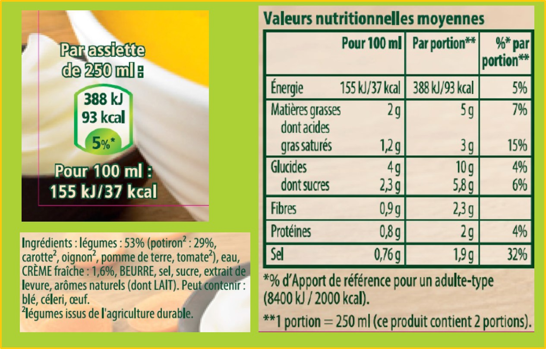
New nutrition labelling

Slide 50
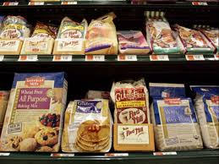
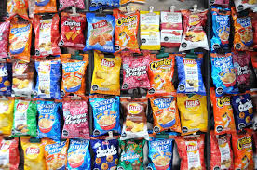
Conclusions
A long list of regulations
….we need to study them in order to comply the consumers needs
….we need to inform consumers how to read them….
ppittia@unite.it

